Slide 1
OOP Using Java
Presented by:
Ghulam Mujtaba Shaikh

Slide 2
Exception Handling

Slide 3
Topics to be covered
Introduction to Exception Handling
Exception Hierarchy
Types of Exception
Some keywords
  try
  catch
  finally
  throws
  Throw
  Making your own exception
Recap

Slide 4
Exception Handling
Types of Errors
  Generally, you can come across three types of errors while developing software. These are Syntax, Logic & Runtime errors.
1. Syntax Errors
Arise because the rules of the language are not followed.
2. Logic Errors
Indicates that logic used for coding doesn’t produce expected output.
3. Runtime Errors
  Occur because the program tries to perform an operation that is impossible to complete.
  Cause exceptions and may be handled at runtime (while you are running the program)
For example divide by zero

Slide 5
What is an Exception?
An exception is an event that usually signals an erroneous situation at run time
Exceptions are wrapped up as objects

Slide 6
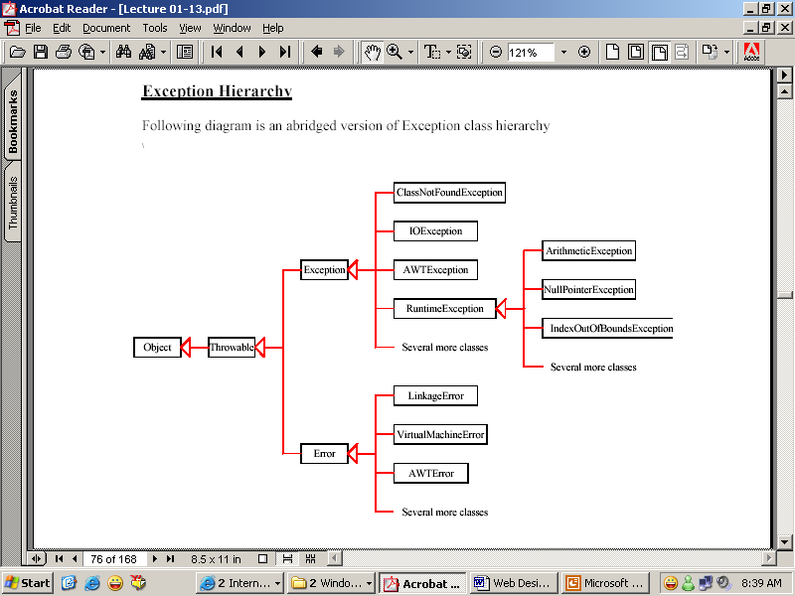
Exception Hierarchy

Slide 7
Types of Exception
Checked exceptions are the exceptions that are checked at compile time by the Java compiler. This means that if a method throws a checked exception, the compiler will check if the calling method handles or declares the exception. If the calling method does not handle or declare the exception, the compiler will throw a compilation error. Examples of checked exceptions in Java include IOException, ClassNotFoundException, and SQLException.
Unchecked exceptions are the exceptions that are not checked at compile time by the Java compiler. This means that if a method throws an unchecked exception, the compiler will not check if the calling method handles or declares the exception. Examples of unchecked exceptions in Java include NullPointerException, ArrayIndexOutOfBoundsException, and IllegalArgumentException.

Slide 8
Handling Exception
try block
catch block
finally block
throw clause
throws clause

Slide 9
Try, Catch and Finally Exception
try block: Write code inside this block which could generate exceptions
catch block: Code inside this block is used for exception handling When the exception is raised from try block, only than catch block would execute.
finally block: This block always executes whether exception occurs or not. Write clean up code here, like resources (connection with file or database) that are opened may need to be closed.
throw keyword: It is used to explicitly throw an exception from within a method or block of code.
throws keyword: It is used in a method signature to indicate that the method can throw an exception. This is used to inform the caller of the method that they need to handle any exceptions that may be thrown by the method.

Slide 10
General Structure of Try, Catch and Finally
try // Try block
{
// write code that could generate exceptions
}
catch (<exception to be caught>) //catch block
{
//write code for exception handling
}
finally //finally block
{
//any clean-up code, release the acquired resources
}

Slide 11
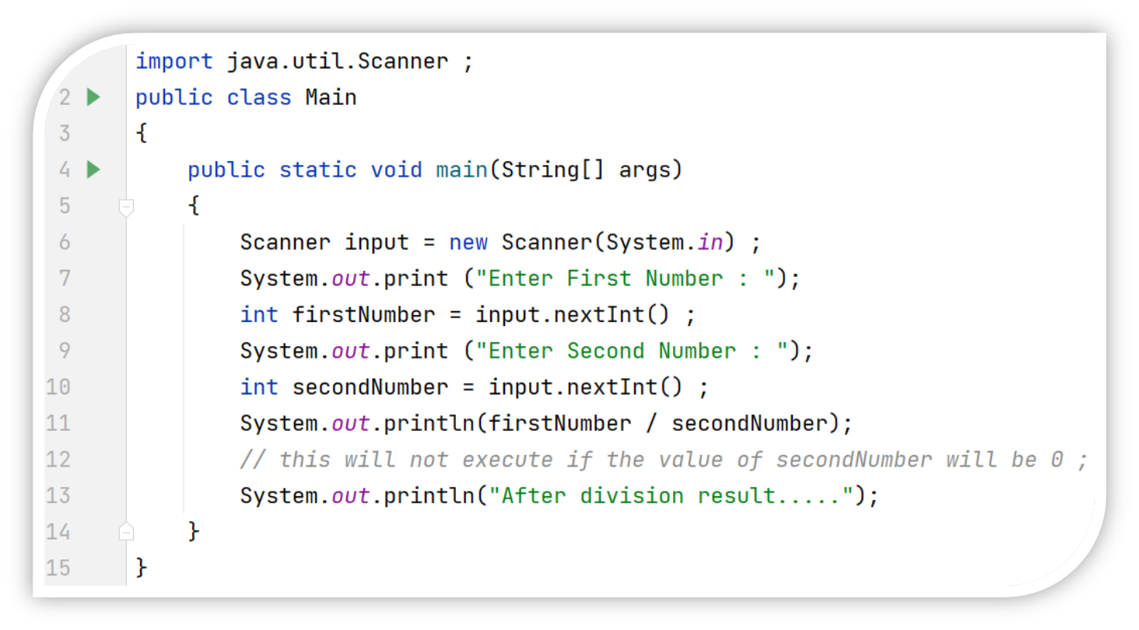
Example No. 1 | Abnormal Halting

Slide 12
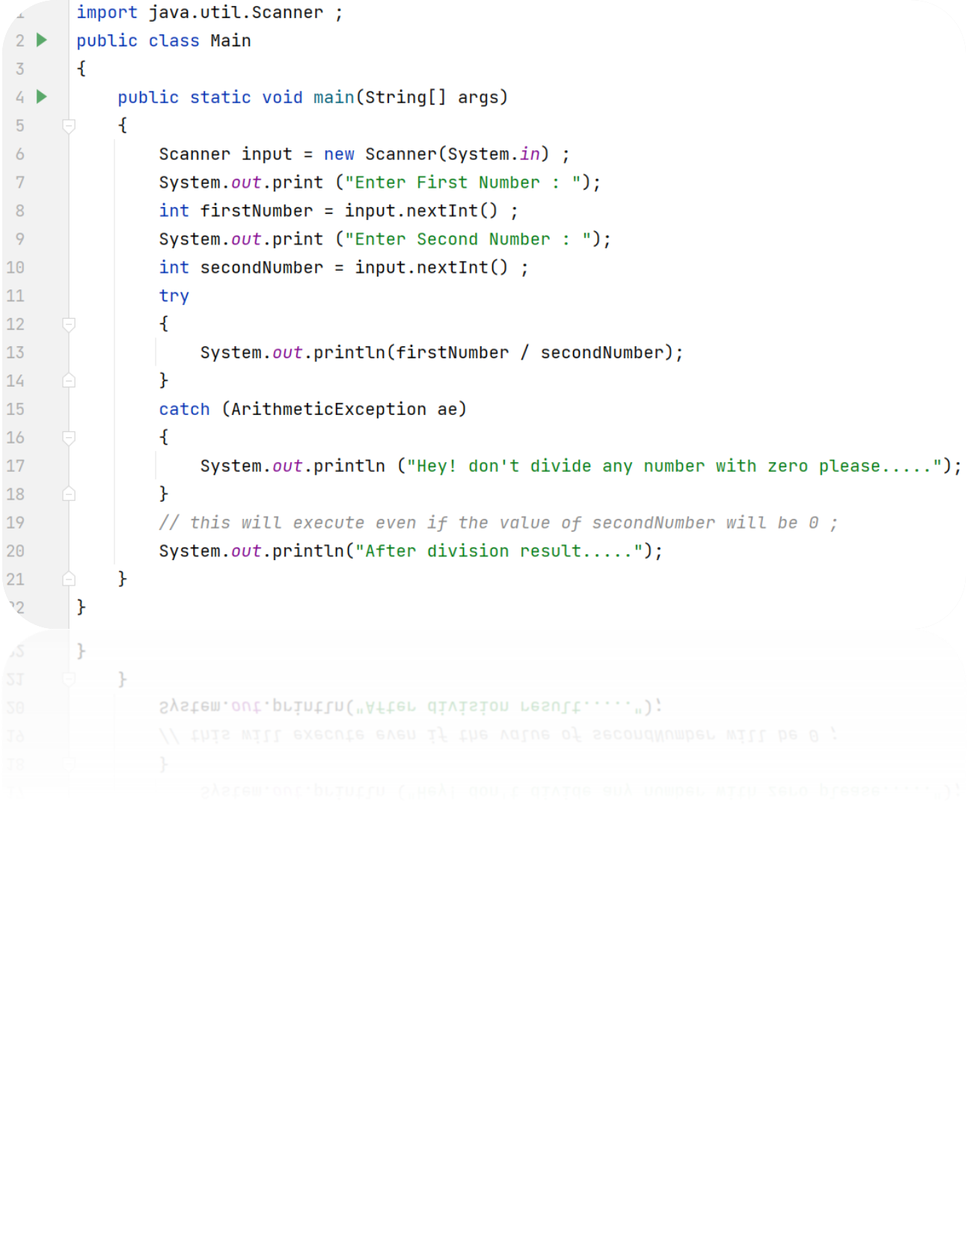
Example No. 2 | Using try and catch

Slide 13
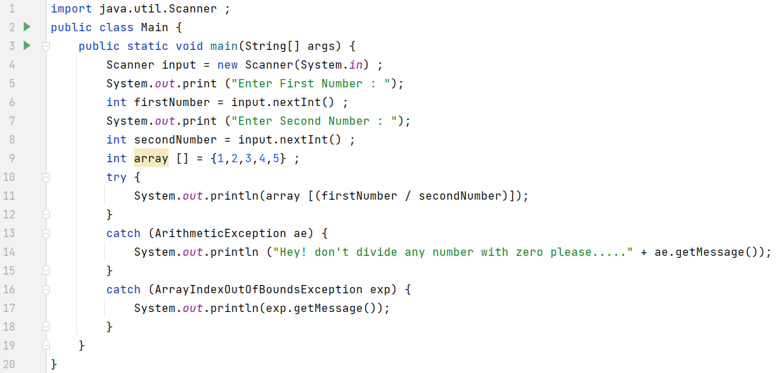
Example No. 4 | Multiple Catches

Slide 14
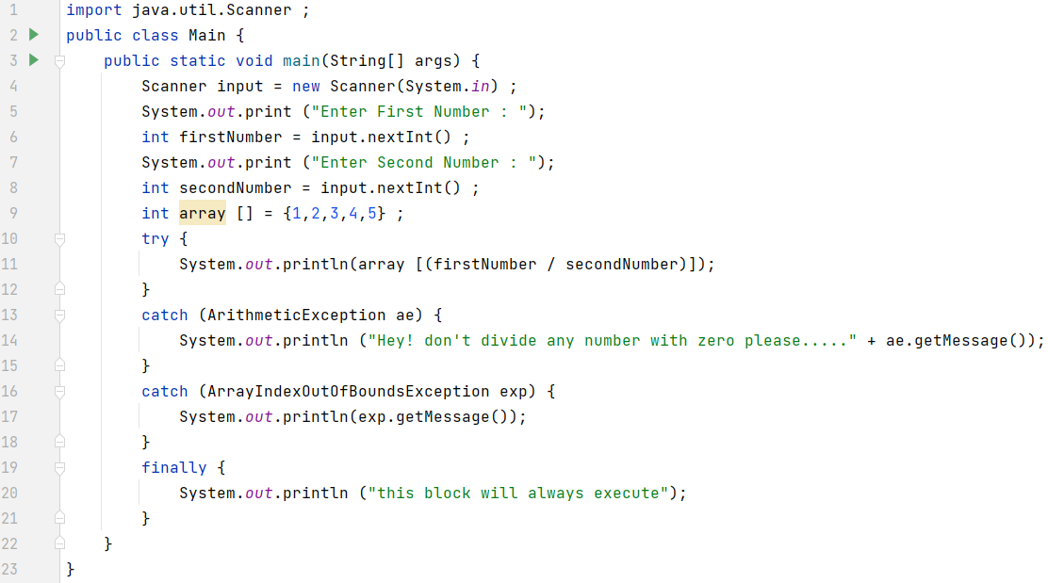
Example No. 4 | finally block

Slide 15
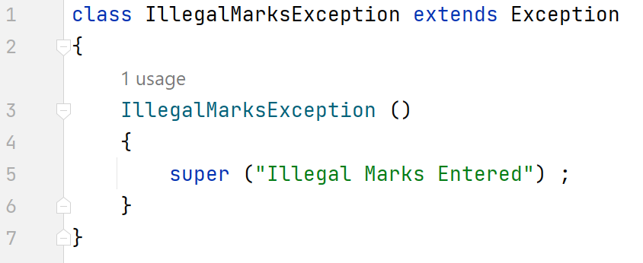
Making Your Own Exception
For creating your own exceptions, you need to create a class for your exception.
Extends that class with Exception class
Override the constructor for showing your own exception message using super constructor

Slide 16
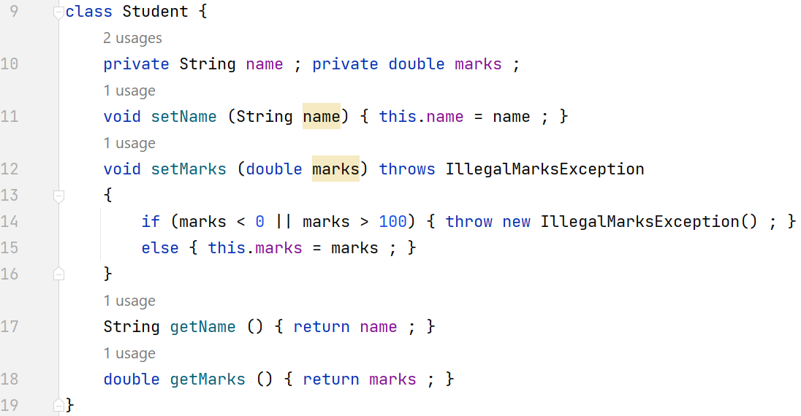
Making Your Own Exception

Slide 17
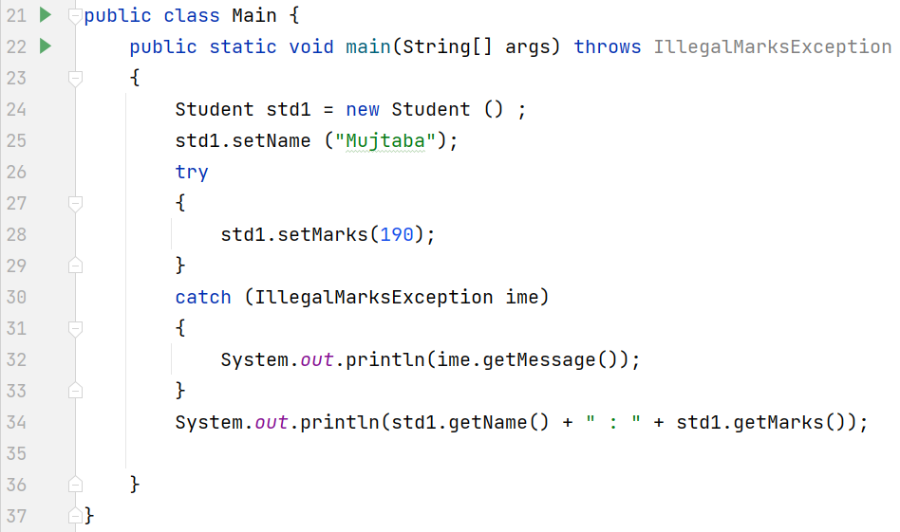
Making Your Own Exception

Slide 18
Recap
Introduction to Exception Handling
Exception Hierarchy
Types of Exception
Some keywords
  try
  catch
  finally
  throws
  Throw
Making your own exception

